Slide 1
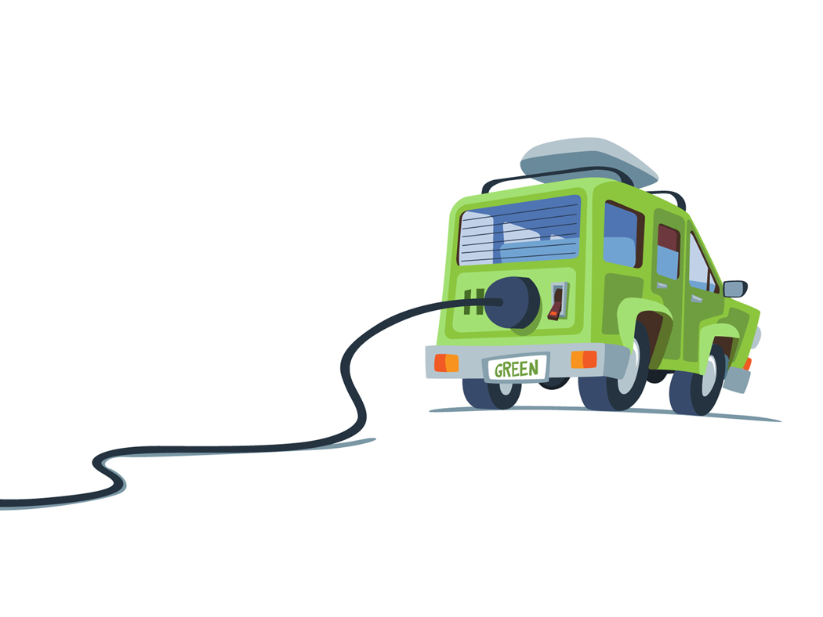
SOLARama EV’s
Affordable Electric Vehicles for around town

Slide 2
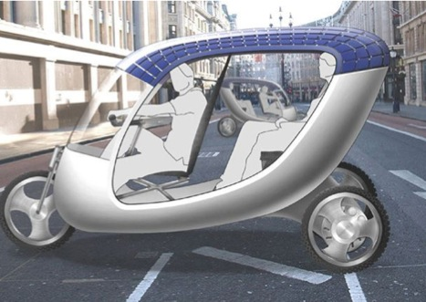
The Idea!
Practical vehicle
Inexpensive
Plug into your 110Volt outlet
Clean Energy
Easy Maintenance
Usage
Shopping
Drop and pick up kids
Small Errands
Pleasure

Slide 3
FACTS
Who wants to human power a vehicle with cargo ?
Young, strong and energetic persons
Very idealistic persons
To earn livelihood (many Asian countries)

Slide 4
MORE FACTS
Who wants to ride an electric powered vehicle?
People who live in relatively flat areas
People who want less pollution
Parents with their children
People who can’t afford to pay for gas

Slide 5
More Facts and Data
The 3 Three’s for an ATV (Around Town Vehicle)
Speed: 30 miles per hour
Range: 30 miles per charge
Cost: $ 3.000 per vehicle

Slide 6
Legal Aspects…..
Helmet required
One time registration ($18)
No Motorcycle Drivers License required (just regular Car Drivers License)
Street legal

Slide 7
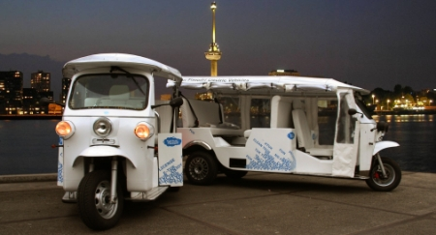
Different Models and Designs are being produced all around the world:
By Dutch company: Tuk Tuk Factory (TTF)
US$15,110 to $19,231

Slide 8
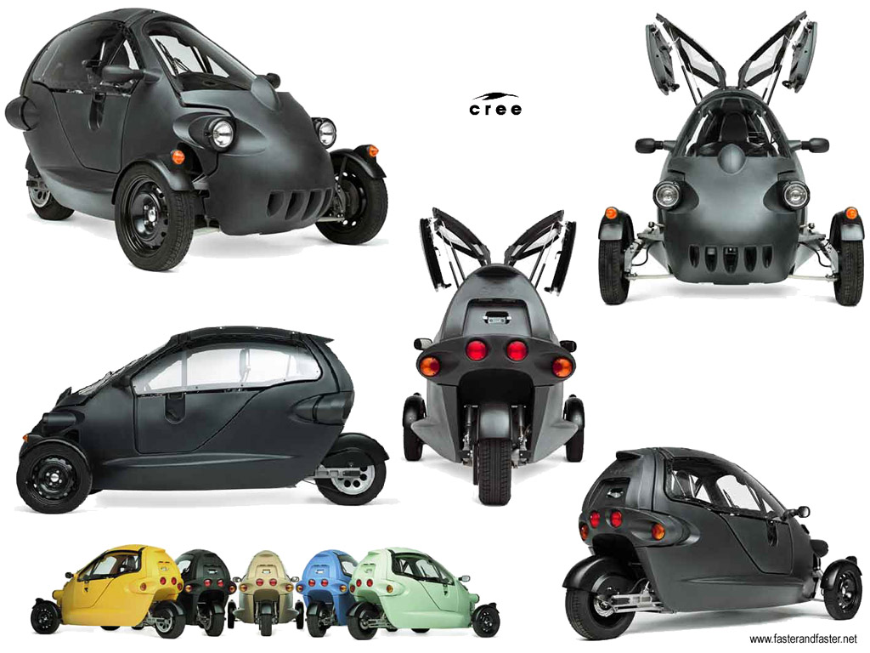
Designed and built by the Swiss-based Cree Ltd., this is SAM, a battery-powered Trike
$ 10,000 +

Slide 9
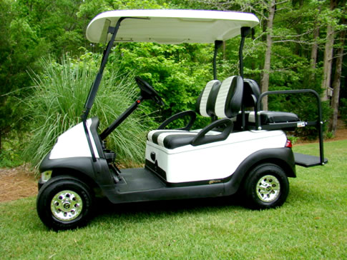
Regular Golf Cart: usually not Street legal
Approximate range of $ 2,500 to 15,000

Slide 10
Be an Investor with SOLARama EV’s
SOLARama Ev’s:
Are for the average and low income consumers (80%+ of the population) and/ or environmental conscious people
Easy to charge ( your electric plug at home)
Charging Time: 3-6 hours
Low cost ($ 3,000-5,000)
ATV (Around Town Vehicle)
For relatively Flat areas
30 mile range per charge
30 miles per hour
For 3-5 people
Cargo space
Nice Design
Open with top cover ( for mild climates )
Enclosed ( for less mild climates )
Cool and Fun
Electric vehicles on the Market so far:
Golf Carts
Expensive
Not street legal
Real Cars (Nissan Leaf )
Cost: $ 40,000
100 mile range
Special Charging stations required
Swiss Trike
Expensive
Too speedy to fall into desired category
Everything else on the Market
Expensive
Cool but not always practical
Average Consumers not considered
Select Consumers

Slide 11
What is needed ?
$ 100,000 Capital
Business Plan
Visit China
Find the required engine, design, batteries, chargers, parts, etc.
Develop Proto Type
Analyze Production Cost / Shipping/ Assembly/ Fees
All Legal Aspects
Distribution Facilities
Get People needed
Etc.

Slide 12
The Proto Type so far….

